Slide 1
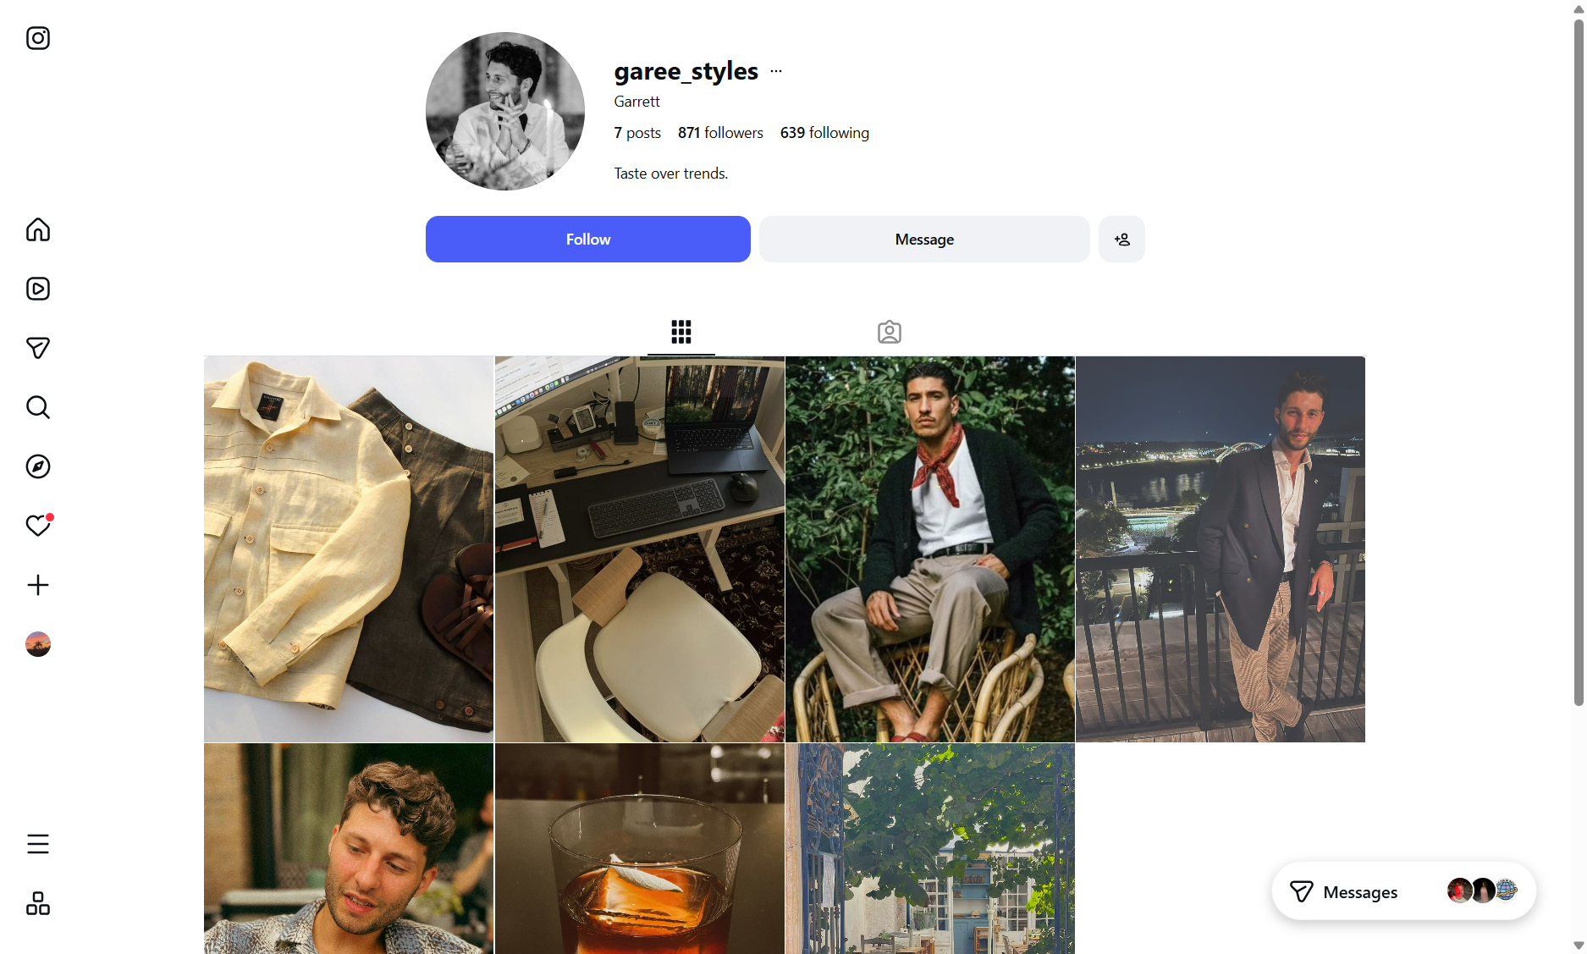
Garrett Shuster
Personal Intelligence Dossier
@garee_styles
2026-03-08

Slide 2
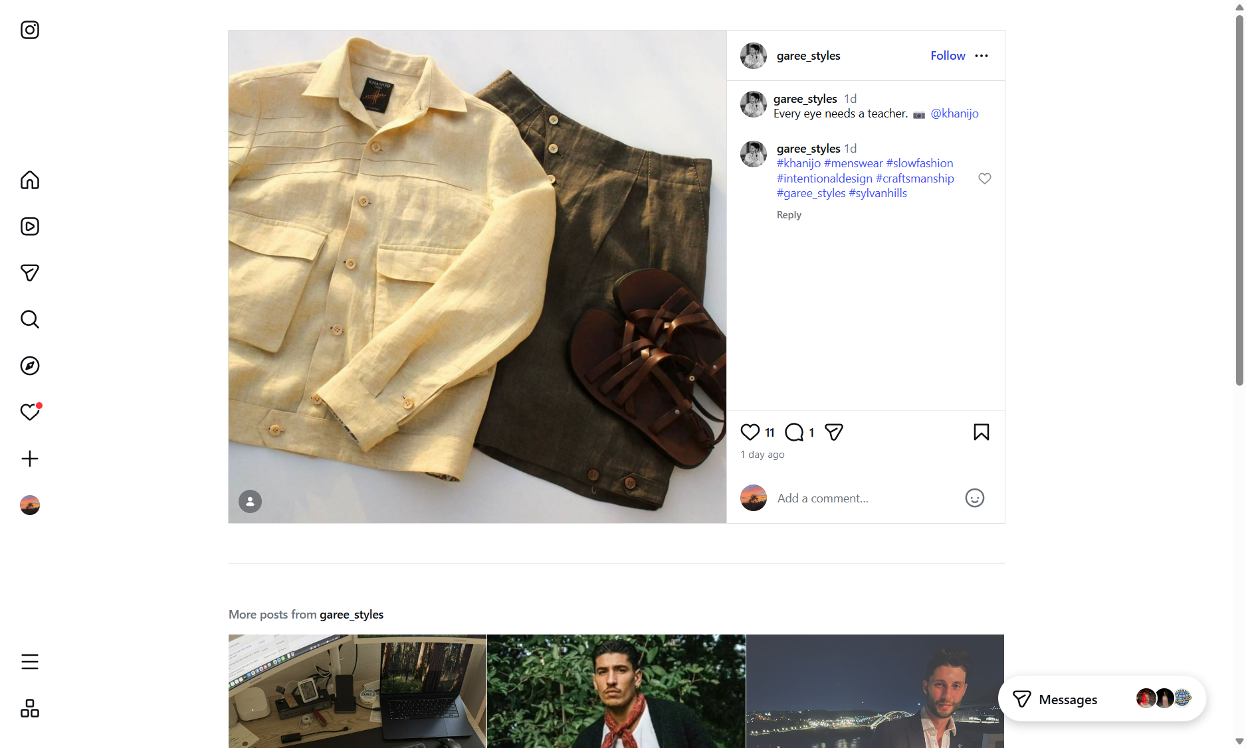
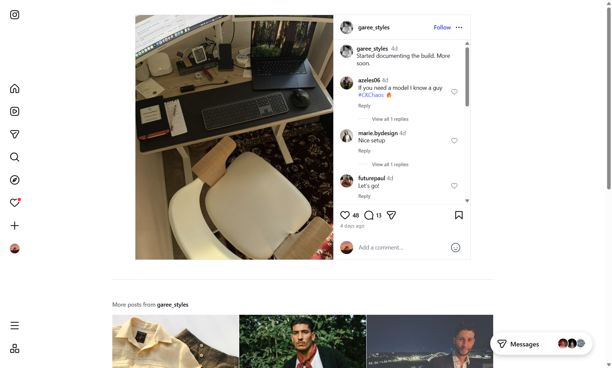
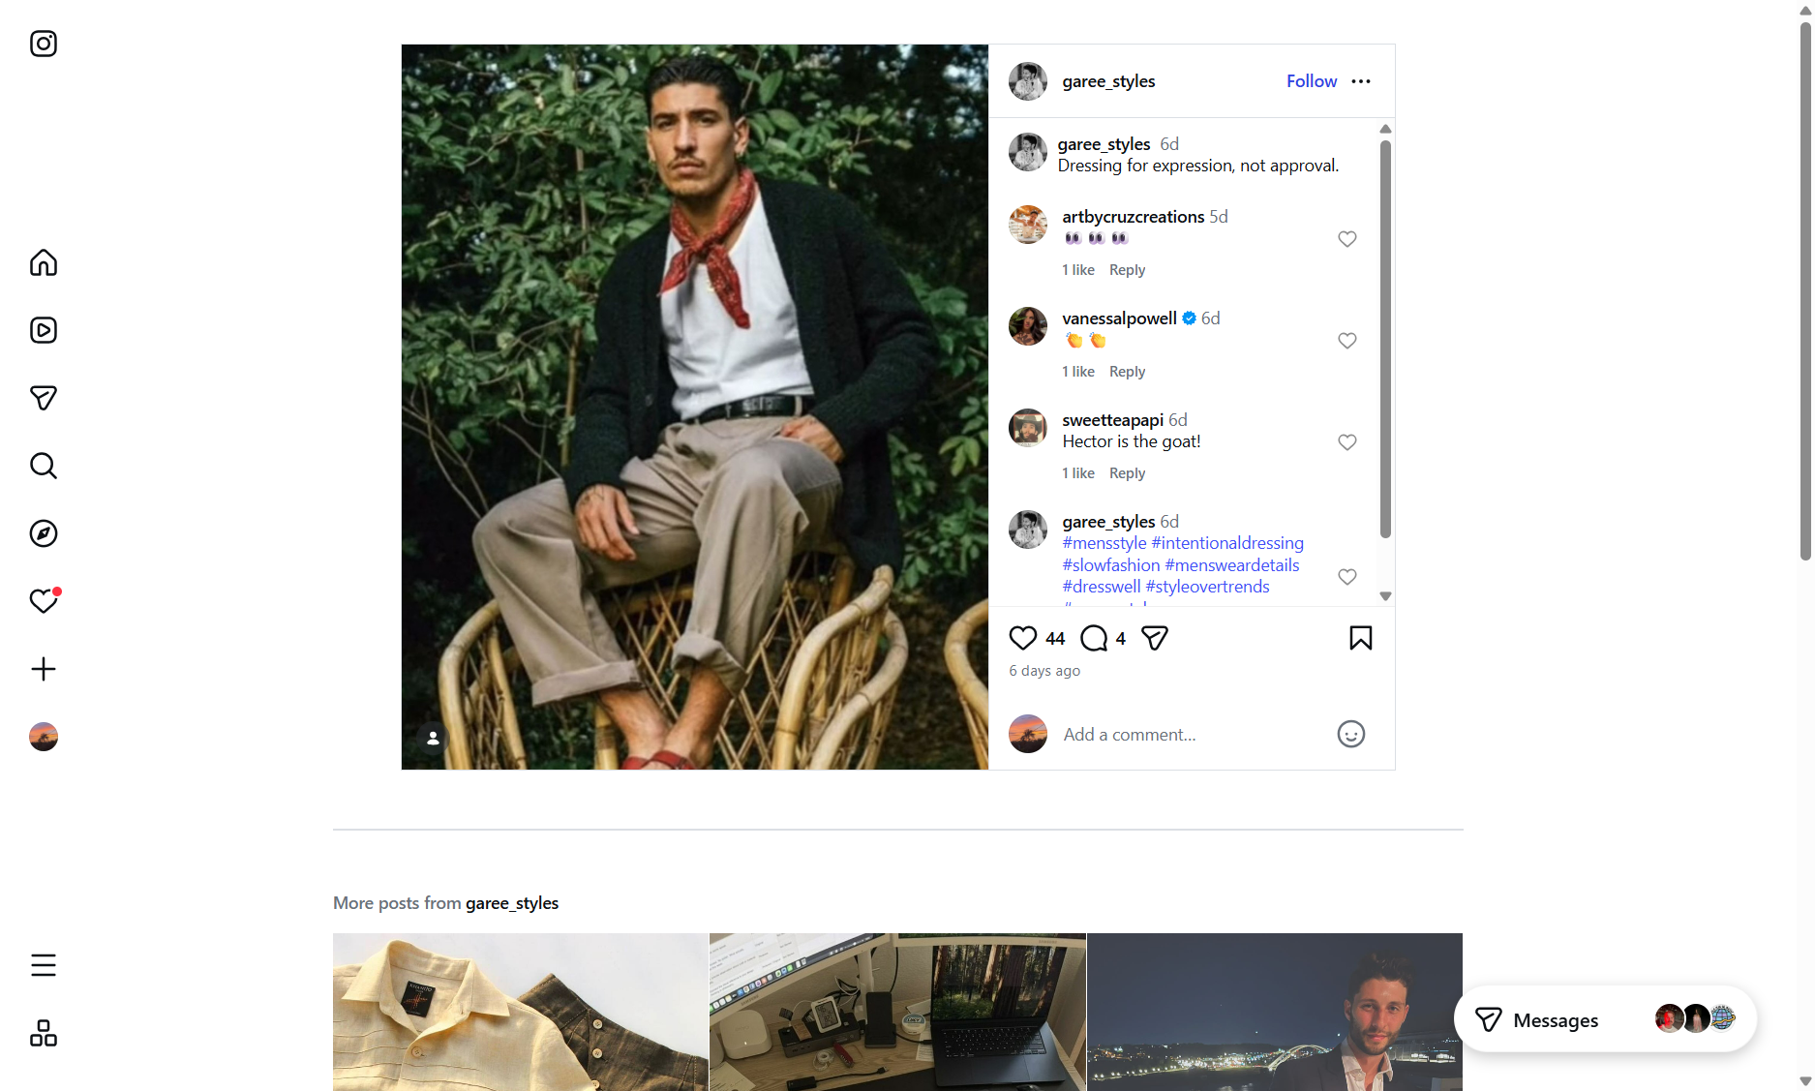
Photo Board

Slide 3
Digital Footprint
Bio: ""Taste over trends.""
Followers: 871 | Following: 639 | Posts: 7
Threads: Not linked
Link in bio: None
Story highlights: None
Content themes: This is unmistakably a menswear and personal style account. Every post is about fashion, self-expression, and intentional design. He's not posting food, travel selfies, or motivational quotes — it
Engagement rate: High for follower count — 871 followers on 7 posts means strong follower-to-content ratio
Post frequency: Sporadic — 4 posts in Jan 2023, then 3 years of silence, then 3 posts in March 2026. This is a project, not a habit.
Comment quality: Excellent — real friends with real names commenting with humor and inside jokes. Zero bot activity. This is a genuine social circle.
Platform strategy: Style account (public, curated) vs personal account (private, 180 posts). He treats fashion content as a separate identity worth building publicly.
Sources: www.instagram.com/garee_styles/p/DVYuT4oDnME/ | www.instagram.com/garee_styles/p/DVd35STERwx/ | www.instagram.com/garee_styles/p/DVlt7weCrmr/

Slide 4
Personal Life
Career
Influences
Project Finance Vice President, Power Sector at MUFG
@khanijo / @mr.khanijo — Indian menswear brand focused on slow fashion, handcrafted garments. Tagged in most recent post. Garrett is genuinely invested in this brand. | @hectorbellerin — Former Arsena
Education
Travel
Penn State (BS Finance), American University Kogod (MBA 2017-2019)
White City, London — posted from there Jan 2023. White City is home to Westfield shopping center and BBC Television Centre — fashion/media district. | Cascais, Portugal — "Table for two" (Jan 2023). R
Location
Hobbies / Lifestyle
Los Angeles, California
This is unmistakably a menswear and personal style account. Every post is about fashion, self-expression, and intentional design. He's not posting; Music (SoundCloud)
Relationship
Background
"Table for two" in Cascais, Portugal + "hard launch" comment = he was in a relationship as of Jan 2023. May or may not be current. LinkedIn Profile Summary | Field | Value | |---|---| | Name | Garrett
At Kogod MBA, Garrett worked on FoodyTV in the New Ventures Start-Up class with classmate Kevin Assie. FoodyTV is a food media startup (next-gen food network for the "Everyday Chef"). He expressed int
Active Project
"Started documenting the build. More soon." (Mar 4, 2026) — posted with laptop/desk/office setup photo Comments: "MEGA desk!", "I'm so locked in!!!!", "Give em hell!", "Lucy >>>" "Lucy" is likely the
Sources: www.linkedin.com/in/garrett-shuster/ | www.instagram.com/garee_styles/p/DVYuT4oDnME/ | www.instagram.com/garee_styles/p/DVd35STERwx/

Slide 5
Conversation Starters
"Taste over trends" — the style account. "I saw @garee_styles — 'Dressing for expression, not approval' is a philosophy, not just a caption. Are you building something in the fashion space?"
The Build. "You posted 'Started documenting the build' — what's the project? Is Lucy a brand?"
Khanijo. "You tagged Khanijo in your latest post — their slow fashion approach is incredible. How'd you discover them?"
Hector Bellerin. "Bellerin's style game is unmatched for a footballer. Is he your top fashion influence?"
Sigma Chi + Penn State. "We're both Sigma Chi Alpha Chi — what years were you at Penn State?"
Cascais, Portugal. "How was Portugal? Cascais looks incredible."
Sources: www.instagram.com/garee_styles/p/DVYuT4oDnME/ | www.instagram.com/garee_styles/p/DVd35STERwx/ | www.instagram.com/garee_styles/p/DVlt7weCrmr/

